Slide 2
Android Architecture components
Presented by Mohamed Wael

Slide 3
Outline
What is Jetpack?
What is Android Jetpack?
Workmanager
Navigation
Android KTX

Slide 4

What is Jetpack?

Slide 5

JetPack
JitPack is a novel package repository for JVM and Android projects.
It builds Git projects on demand and provides you with ready-to-use artifacts.
If you want your library to be available to the world, there is no need to go through project build and upload steps.
All you need to do is push your project to GitHub and JitPack will take care of the rest. That’s really it!

Slide 6
How to publish to JetPack
Create the required library
In root build.gradle
In your library/build.gradle
dependencies { ... classpath 'com.github.dcendents:android-maven-gradle-plugin:2.1'
apply plugin: 'com.github.dcendents.android-maven' group='com.github.UserName'

Slide 7
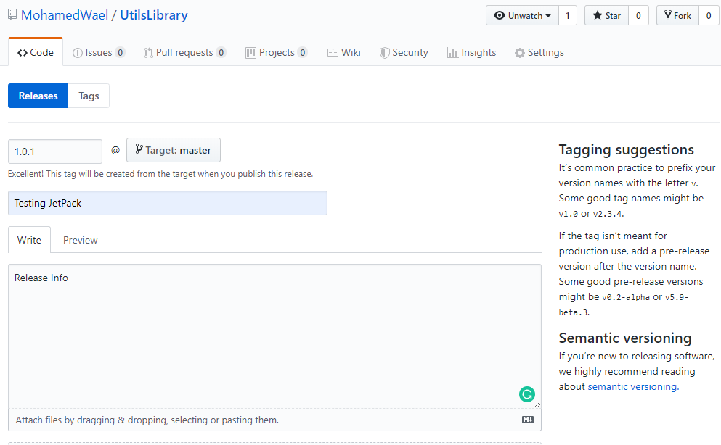
How to publish to JetPack
Push it to Github
Create a release

Slide 8
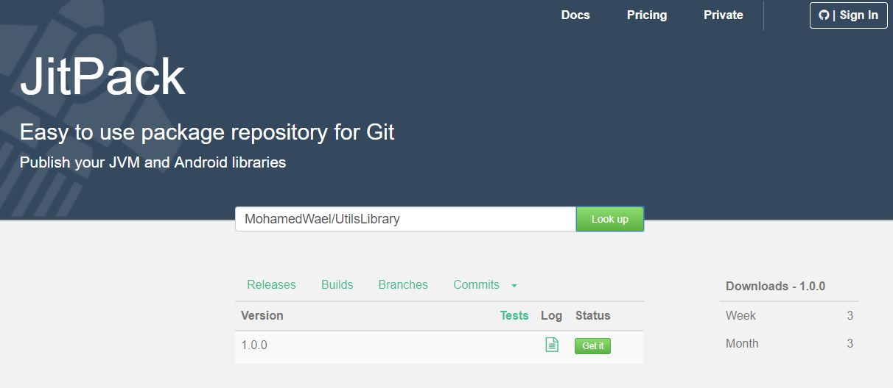
How to publish to JetPack
Now, head to https://jitpack.io/ and enter the address of your repository in the search box and you will receive the address of your library!

Slide 9
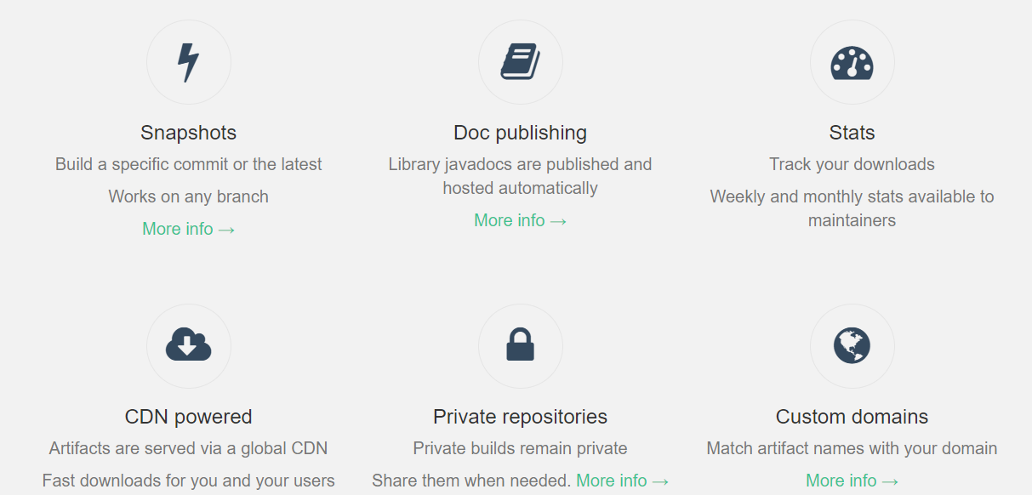
JetPack features

Slide 10

What is Android Jetpack?

Slide 11
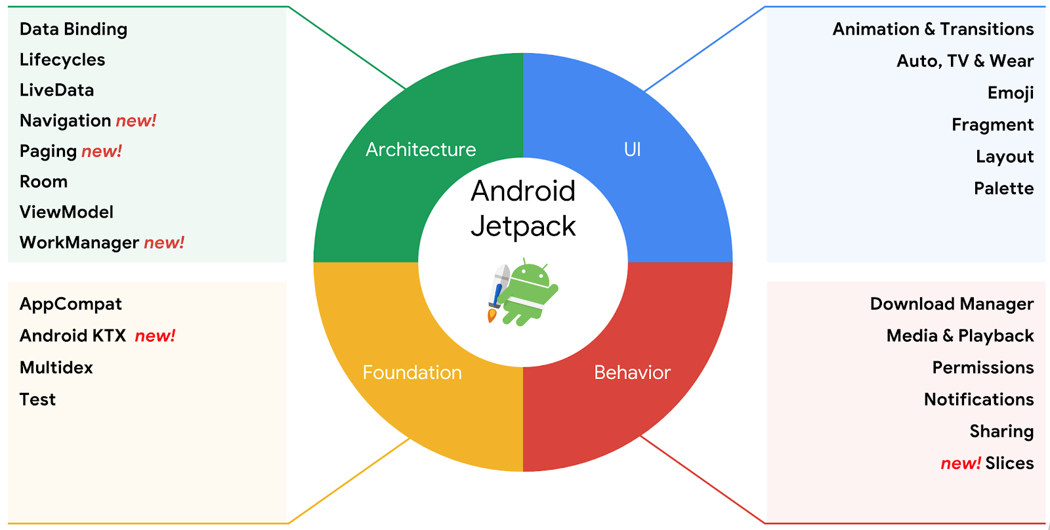
Android Jetpack
Android Jetpack is a set of components, tools and guidance to make great Android apps.
The Android Jetpack components bring together the existing Support Library and Architecture Components and arranges them into four categories

Slide 13
WorkManager
The WorkMananager component is a powerful new library that provides a one-stop solution for constraint-based background jobs that need guaranteed execution, replacing the need to use things like jobs or SyncAdapters.
It is intended for tasks that are deferrable — that is, not required to run immediately — and required to run reliably even if the app exits or the device restarts. For example:
Sending logs or analytics to backend services
Periodically syncing application data with a server
Backwards compatible up to API 14
Uses JobScheduler on devices with API 23+
Uses a combination of BroadcastReceiver + AlarmManager on devices with API 14-22

Slide 14
WorkManager
Add work constraints like network availability or charging status
Schedule asynchronous one-off or periodic tasks
Monitor and manage scheduled tasks
Chain tasks together
Ensures task execution, even if the app or device restarts
Adheres to power-saving features like Doze mode
Find more about WorkManger here

Slide 15
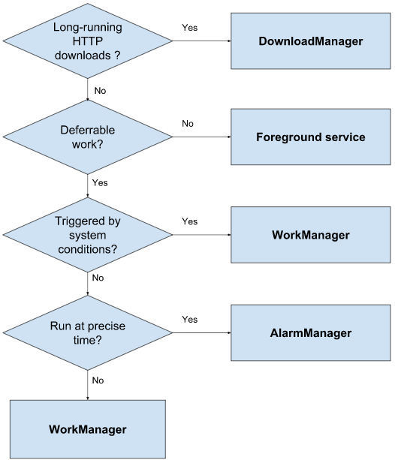
WorkManager

Slide 16

WorkManager

Slide 17
WorkManager
Adding work manager in app/build.gradle
WorkManager Basics
Worker: This is where you put the code for the actual work you want to perform in the background. You'll extend this class and override the doWork() method.
WorkRequest: This represents a request to do some work. You'll pass in your Worker as part of creating your WorkRequest.
When making the WorkRequest you can also specify things like Constraints on when the Worker should run.
dependencies { ... implementation "androidx.work:work-runtime-ktx:2.2.0"

Slide 18
WorkManager
WorkManager Basics
WorkManager: This class actually schedules your WorkRequest and makes it run.
It schedules WorkRequests in a way that spreads out the load on system resources, while honoring the constraints you specify.
Creating the first worker:
In the package workers, create a new class called BlurWorker and extend Worker.
Implement the required work in the doWork() method
class BlurWorker(ctx: Context, params: WorkerParameters) : Worker(ctx, params) { override fun doWork(): Result {} }

Slide 19
WorkManager
Creating the first worker:
In your viewModel create the workManager instance
Enqueue the WorkRequest in WorkManager
There are two types of WorkRequests:
OneTimeWorkRequest: A WorkRequest that will only execute once.
PeriodicWorkRequest: A WorkRequest that will repeat on a cycle.
private val workManager = WorkManager.getInstance(application)

Slide 20
WorkManager
Enqueue the WorkRequest in WorkManager
We only want the blurWorker to be executed once when the Go button is clicked.
The applyBlur method is called when the Go button is clicked,
so create a OneTimeWorkRequest from BlurWorker there.
Then, using your WorkManager instance enqueue your WorkRequest.
internal fun applyBlur(blurLevel: Int) { workManager.enqueue(OneTimeWorkRequest.from(BlurWorker::class.java)) }

Slide 21
Resources
What is Android JetPack: https://android.jlelse.eu/what-is-android-jetpack-737095e88161
android-workmanager: https://github.com/googlecodelabs/android-workmanager
Background Work with WorkManager - Kotlin: https://codelabs.developers.google.com/codelabs/android-workmanager-kt/#0

